Slide 1

Link-state Routing Protocol
Objective - 2

Slide 2

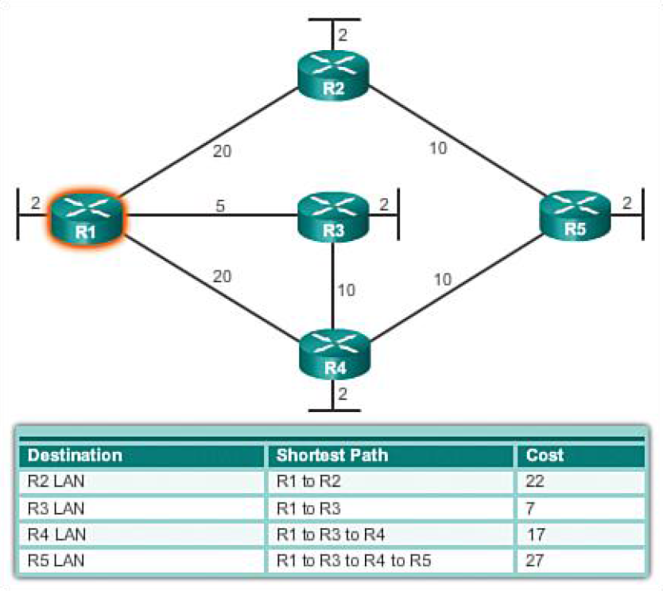
Link State Routing also known as shortest path first algorithm.
The shortest path to a destination is not necessarily the path with the least number of hops.
In link state routing, each node has a complete map of the topology.
If a node fails, each node can calculate the new route.
Introduction

Slide 3
Link State routing protocols do not view networks in terms of adjacent routers and hop counts, but they build a comprehensive view of the overall network which fully describes the all the possible routes along with their costs.
Link state routers has two phases:
First - Reliable flooding which tells all the routers about the local topology.
Second - Path calculation (Dijkstra's algorithm) to calculate best path over complete network.
Introduction

Slide 4
Link State Routing Protocol Process
The routers learn about the directly connected networks.
Routers exchange hello packets to neighbors – To discover neighbors that use the same link state routing protocol on its link.
Routers then build Link State Packets (Link State Packets contains the link id, link state, cost).
Routers then flood LSPs to all neighbors.
Routers calculate the best path to each destination with the help of the LSP database to build the network topology.

Slide 5
Dijkstra's Algorithm
It is also called as the single source shortest path algorithm.
It is one of the classic examples of the application of greedy programming technique.
Dijkstra’s algorithm finds the shortest paths to a graph's vertices in order of their distance from a given source.
It finds the shortest path from the source to a vertex nearest to it, then to a second nearest and so on.

Slide 6
Dijkstra's Algorithm
Notations used:
c(i, j): Link cost from node i to node j. If i and j nodes are not directly linked, then c(i, j) = ∞.
D(v): It defines the cost of the path from source code to destination v that has the least cost currently.
P(v): It defines the previous node (neighbor of v) along with the current least-cost path from source to v.
N: It is the total number of nodes available in the network.

Slide 7
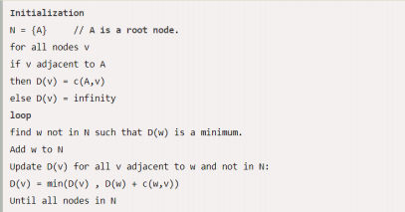
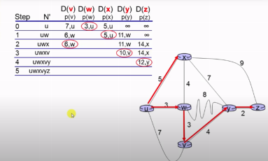
Dijkstra's Algorithm

Slide 8

Advantages of Link-state Routing Protocol
Router can independently determine the shortest path to every network.
Smaller routing tables.
A periodic/ event driven routing updates.
Faster convergence.

Slide 9
Disadvantages of Link-state Routing Protocol
Link State Routing Protocol require higher processing power when compared Distance Vector Protocols.
Link State Routing Protocol require more memory.
Initial flooding may degrade the performance of the network.

Slide 10
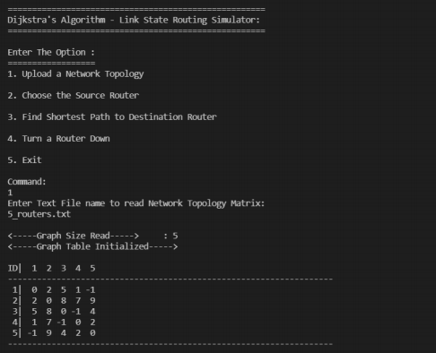
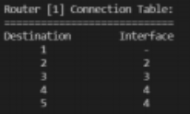
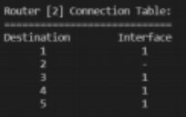
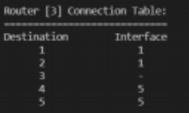
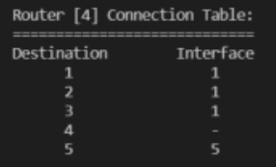
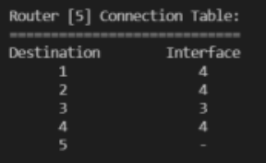
A Network topology which has 5 Routers is selected. The Input matrix is read from the input file, 5_routers.txt and the Network topology matrix is displayed on the Console along with the connection table of all routers.

Slide 11
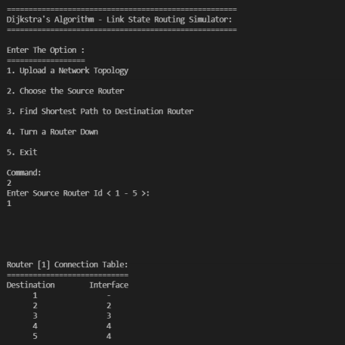
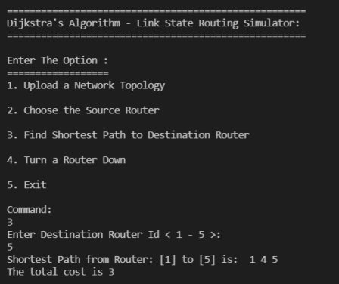
The Source Router is selected to be 1 and the connection table of that router is displayed in the console.
The Destination Router is selected to be 5 and the shortest path cost from router 1 to router 5 is calculated and displayed in the console along with the shortest path taken.

Slide 12
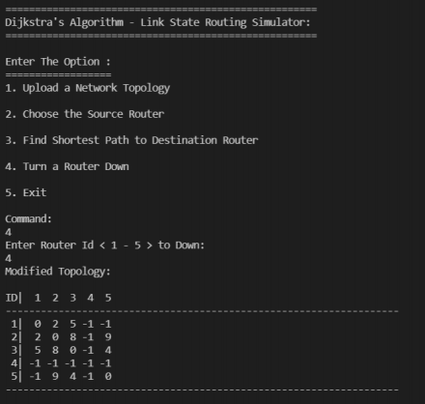
The topology is changed by turning off the router 4 and the changed topology is displayed in the console.

Slide 13
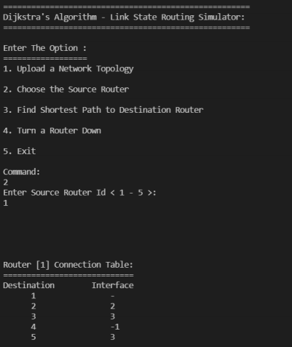
Again, the same Source Router is selected (router 1) and the connection table of that router is displayed in the console.
There is a change in the connection table, because the router 4 is now down.

Slide 14
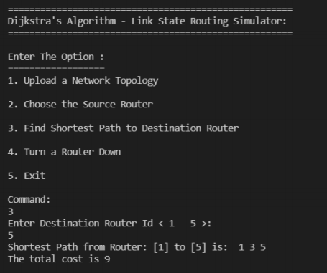
Now when the Destination Router is selected to be 5, the shortest path cost from router 1 to router 5 is changed to 9 and the shortest path taken is 1 → 3 → 5 instead of 1 → 4 → 5 because the router 4 which was an intermediate router in the shortest path is now down.

Slide 15
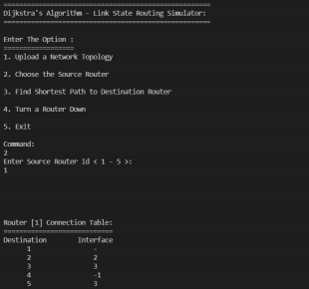
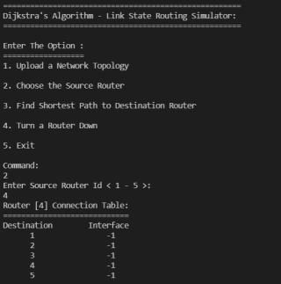
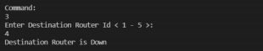
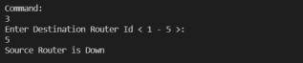
Now, if we select some router as source and router 4 as destination, we can see that it says “Destination Router is Down” when asked for the shortest distance.
Similarly, if we select router 4 as the source, we can see that it says “Source Router is Down” when asked for the shortest distance.

Slide 16
The Link State Routing Protocol is implemented using Dijkstra’s algorithm.
It is tested against different cases including Link-Cost Change and path change, Link Failure.
This project has been tested for various number of routers like 5 routers, 10 routers, 12 routers, 15 routers, 20 routers etc.
Result

Slide 17
https://www.javatpoint.com/link-state-routing-algorithm
https://en.wikipedia.org/wiki/Link-state_routing_protocol
https://www.youtube.com/watch?v=kW6zV-040SY
References

Slide 18
Thank You

